Slide 1

Pre- PhD Thesis Presentation on An Alternative Approach to Redefine Apriori Algorithm by Reducing the Time Complexity Using Textual Data
For the degree of
Doctor of Philosophy
Date 10/06/2025
Presented By:
Sandeep Kumar
(Roll No. 19103001)
Supervised By:
Prof. (Dr.) Rahul Kumar Misha
Professor
School of Computer Science & Applications
School of Computer Science & Applications
IFTM University, Moradabad

Slide 2
Table of Content:
1. Introduction of Data Mining
2. Data Mining Process
3. Data Mining Techniques
3.1. Classification
3.2. Associations Rules Mining (ARM)
4. Introduction of Apriori Algorithm
4.1. Market Basket Analysis
4.2. Apriori Algorithm & Flow Chart
4.3. Apriori Example
4.4. Limitations of Apriori
5. Classification and Comparison Literature Review
6. Comparison for Research Gap
7. Objectives of Proposed Work
8. Research Gap
9. Specific Objectives
10. Research Methodology
11. Proposed Work
12. Experimental work
13. Result Analysis
14. Conclusion
15. Research Publication & Conferences

Slide 3
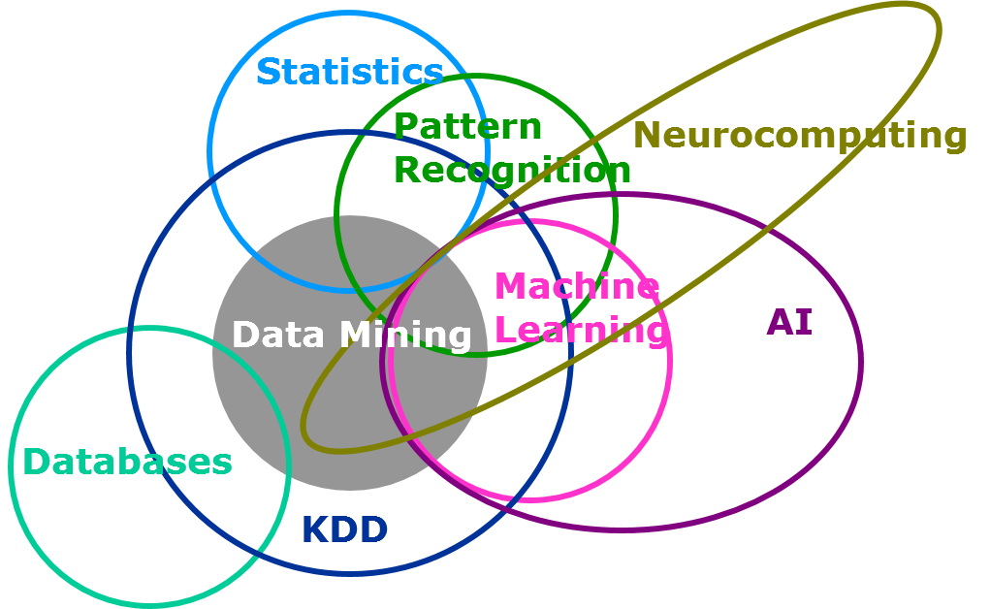
1. Introduction of Data Mining
Discover Knowledge from large amount of data.
Discover interesting patterns.
Mining of Data
Covers techniques like Classification, Clustering, Association Rule Mining etc.

Slide 4
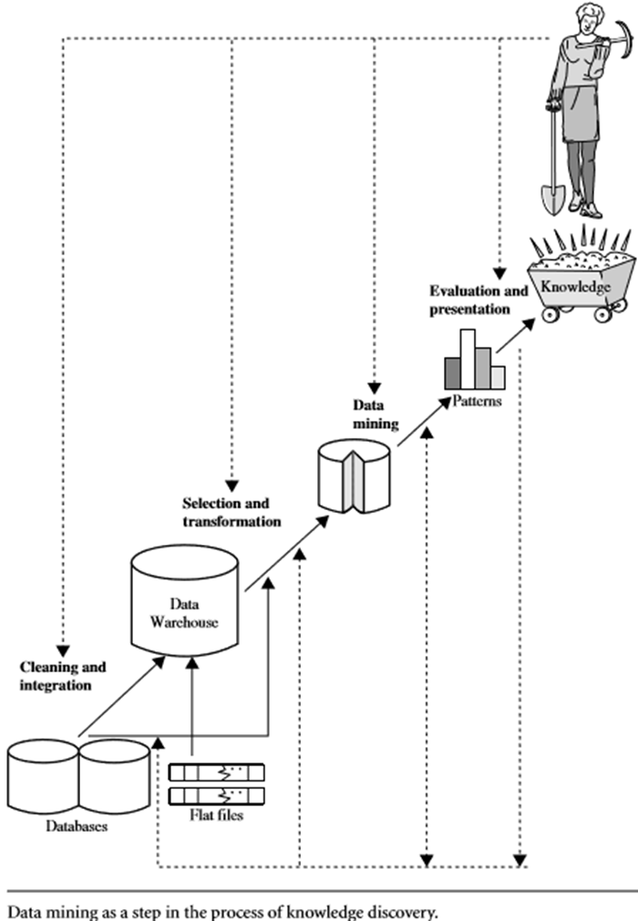
2. Data Mining Process
1) Data Cleaning.
2) Data Integration.
3) Data Reduction.
4) Data Transformation.
5) Data Mining.
6) Pattern Evaluation.
7) Knowledge Representation.
Step-1 to Step-4 : Pre-Processing Steps

Slide 5
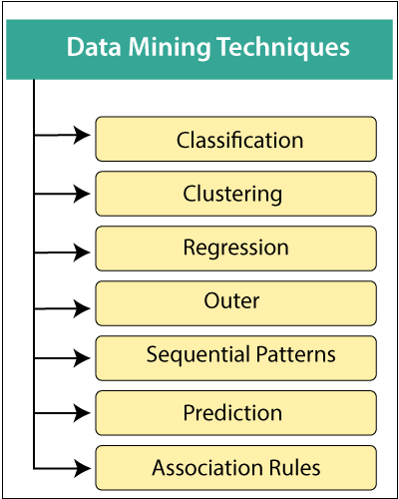
3. Data Mining Techniques
Our Research work is entirely emphasis on Classification Through Association Rule Mining

Slide 6
4. Classification
Works on two phases-
PHASE-1
A) Learning Phase
Supervise Learning
Unsupervised Learning
PHASE-2
B) Classification phase
Association rules
Good Classification entirely based on Knowledge base created by Association rules.

Slide 7
5. Associations Rules Mining (ARM)
--ARM is basically ‘if – then’ rule
(used to classify the item from the item set as per interestingness criteria)
--Interestingness criteria can be define by two parameters-
1) Lower bond or, Lower Threshold [Min_Support Rule]
General Formula:
R: X → Y => P(XUY)
2) Upper bond or, Higher Threshold [Min_Confidence Rule]
General Formula:
R: X → Y => P(Y/X)
.

Slide 8
For a Textual Information-
“if a person (X) Buy a Uniform in June then he also Buy a School Bag”
an association rule R can be defined as-
R1: Buy (X, Uniform) → Buy (X, School_Bag)
Let R1: TRUE
(iff it Pass lower Threshold, ie, Min_Supp() )
Then,
(Uniform & Bag) are Frequent item sets

Slide 9
If rule R1 will be found true in reverse as per threshold criteria like-
R2: Buy (X, School_Bag) → Buy (X, Uniform)
Let R2: TRUE
(iff R1 is True & Pass Upper Threshold, ie, Min_Conf() )
Then,
(Uniform & Bag) are Interesting item sets

Slide 10


6. Introduction of Apriori Algorithm
Proposed by Agrawal and Srikant in 1994
Market Basket Analysis
For Mining Frequent Item set
For Mining Association Rules
Operate on Dataset containing transactions.

Slide 11

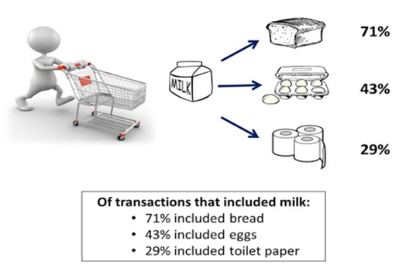
7. Market Basket Analysis
A large number of people use to visit shopping malls and shopping centers.
Massive amounts of data continuously being collected and stored as transactions.
One basket tells you about what one customer purchased at one time.
Those collected data can be useful from the business prospective to find frequently purchased item sets from large transactional database

Slide 12


Market Basket Analysis
The process of discovering frequent item sets in large transactional database is called Market Basket Analysis.
Frequent item set mining leads to the discovery of associations and correlations among items using concept of Data Mining.
Apriori Applies on Market Basket Analysis

Slide 13
Contd…
Apriori works on ARM along with two parameters-
1) Lower bond or, Lower Threshold [Min_Support Rule]
“Which States that “How Frequently Rules are Appear in Data set”.
General Formula:
R: X → Y => P(XUY)
2) Upper bond or, Higher Threshold [Min_Confidence Rule]
“Which States that “How Often Rules are Suppose to be True in Data set”.
General Formula:
R: X → Y => P(Y/X)

Slide 14
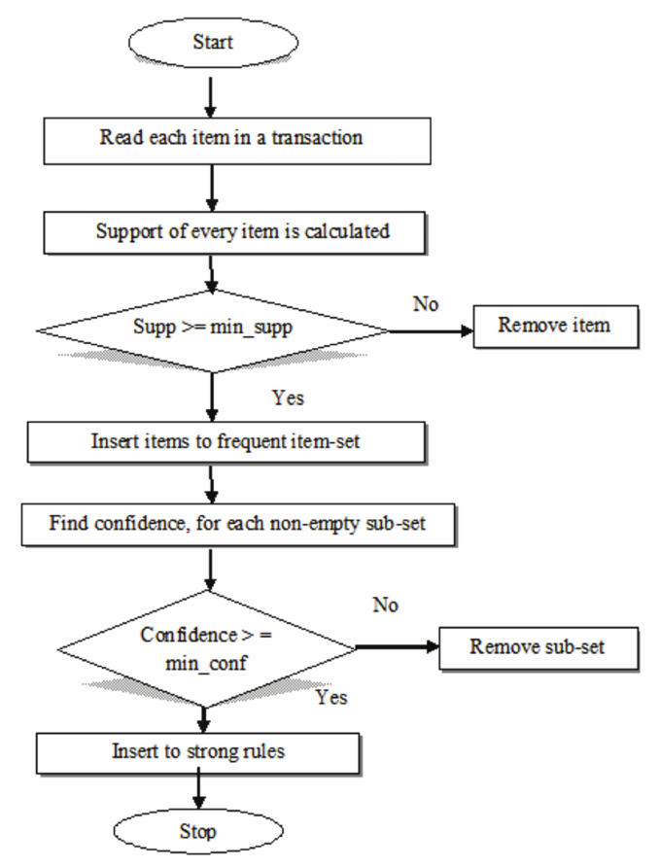
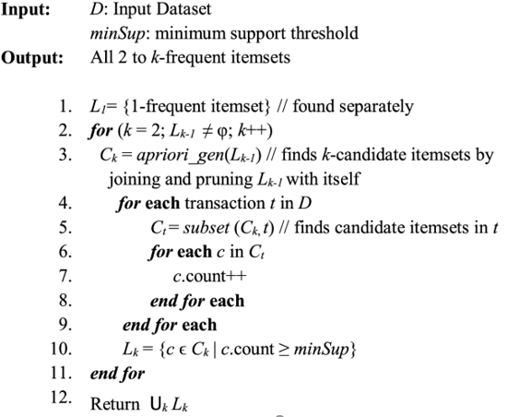
8. Apriori Algorithm & Flow Chart

Slide 15
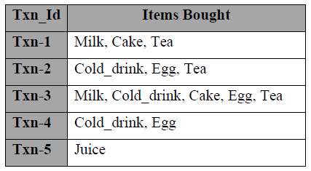
9. APRIORI EXAMPLE
Suppose take an example of the Apriori Algorithm from transactional data set containing five transactions holding products from set of item sets{Milk, Cold_drink, Juice, Cake, Egg, Tea}.
Let Minimum Support is 2
Transactional data set for Apriori Algorithm

Slide 16
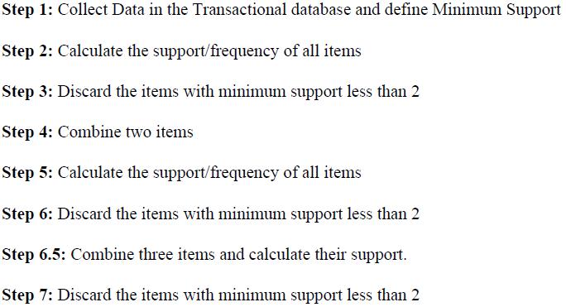

Slide 17
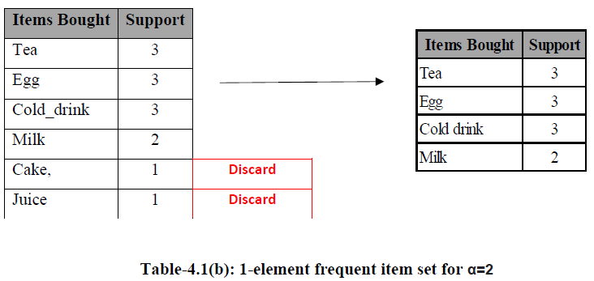
Now Applying Assertion Rule Mining with minimum support (Suppose Minimum Support[α] =2) and find one element frequent item set-

Slide 18
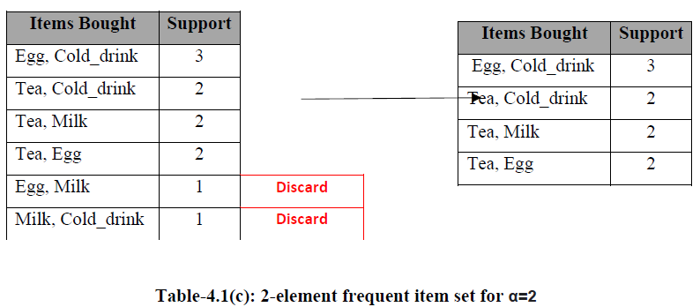
Now Applying Assertion Rule Mining by applying minimum support (Suppose Minimum Support[α] =2) and find two element frequent item set-

Slide 19
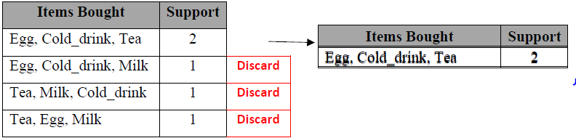
Now Applying Assertion Rule Mining by applying minimum support (Suppose Minimum Support[α] =2) and find three element frequent item set-

Slide 20
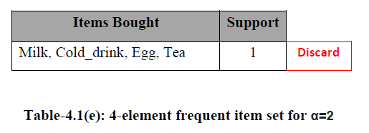
Now Applying Assertion Rule Mining by applying minimum support (Suppose Minimum Support[α] =2) and find four element frequent item set-

Slide 21
10. Limitations of Apriori
Apriori Algorithm works for all combinations of data items appeared in all transaction whether that combination appeared in transaction or not.
Looking for 1- element to n-element item set to be frequent which required more and more recursive iterations, where n is total number of items appeared in all transactions.
Due to such recursive iterations degrades the run time of Algorithm.
Due to the same it required more Memory to store such run time iterations which leads to space and time complexity of algorithm.

Slide 22
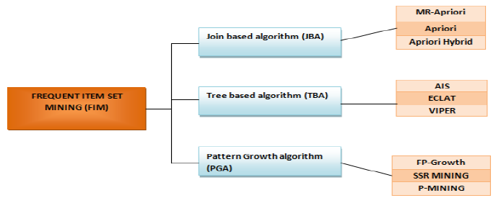
11. Classification and Comparison of Frequent Pattern Mining Algorithms

Slide 23
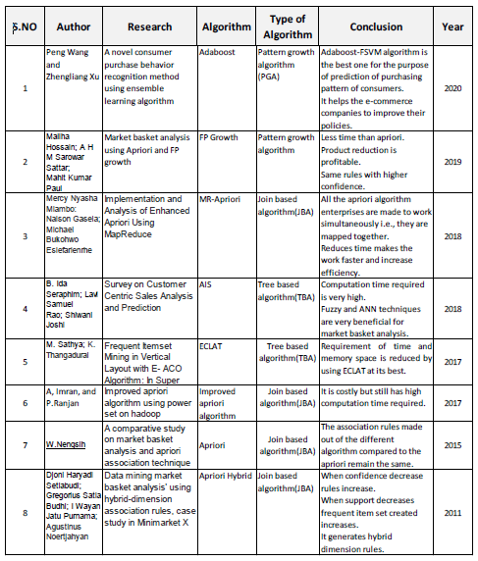
12. Comparison for Research Gap
As per the detailed discussion over various Data Mining Algorithm, Apriori Algorithm required recursive traversal of transactions for finding frequent item sets among the number of item sets containing transactions

Slide 24
OBJECTIVES OF PROPOSED WORK
The main objective of this research work is to develop an efficient Heuristic Apriori Algorithm to generate frequent item sets and use these frequent item sets for generating association rules from Textual data.

Slide 25
RESEARCH GAP
Apriori Algorithm takes large Computation Time as it scans database again and again.
The algorithm scans the database too many times, which reduces the overall performance.
Time and space complexity of this algorithm is very high.

Slide 26
RESEARCH METHODOLOGY
1. Take Text data from Departmental store
2. Use Apriori algorithm and record access time (RT1) to find n-element item sets.
3. Apply Heuristic Algorithm and record access time (RT2) to find n-element item sets.
4. Compared RT1 and RT2 with respect to traditional Apriori and Heuristic Apriori for performance measure
5. If RT2 < RT1 then, It will be observed that Heuristic Apriori Algorithm gives better Performance with respect to time.
6. Python will be used for the Same.

Slide 27
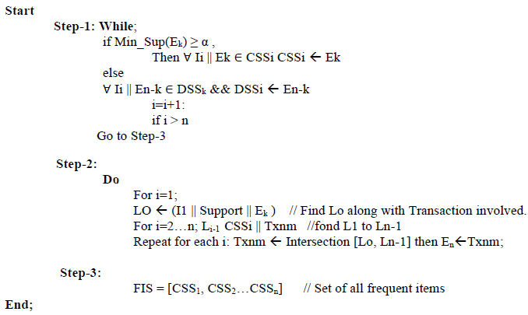
PROPOSED WORK

Slide 28
EXPERIMENTAL WORK
For an execution of Heuristic Apriori, we taken the data set of 50039 transaction from US based departmental store available at Kaggle.
The data set was first cleaned and processed. As per statistics described in table 1.
Result is calculated over intel i7 Processor with 16 GB of RAM using python v3.10 over the variable length of data from low to high volume of transaction sets described in Table 1.

Slide 29
EXPERIMENTAL WORK
Hear we take data set in variable length like four Data set(DS) of a departmental store, DS-1with the statistics among one contains 22039 number of Transactions with 4215 number of items , DS-2 contains 15000 No of Transactions with 4089 number of items, DS-3 contains 9000 No of Transactions with 3922 number of items and DS-4 contains 4000 No of Transactions with 3641 number of items as shown in Table-3,

Slide 30
PROPOSED WORK
Data Set | No of Items(I_{i}) & No of Transactions (Txn) | Min_Sup() in %age | Execution Time-Apriori (T_{A}) in MiliSec | Execution Time- Heuristic Apriori (T_{HA}) in MiliSec | Execution Time Difference-(T_{A}-T_{HA}) | Execution Rate(%)
DS-1 | Ii=4215 & No of Txn=22039 | 30 | 6159.35 | 2775.66 | 3383.69 | 55
 |  | 50 | 2755.11 | 2727.01 | 28.10 | 1
 |  | 70 | 2712.58 | 2704.26 | 8.32 | 0
DS-2 | Ii=4089 & No of Txn=15000 | 30 | 4084.97 | 1839.23 | 2245.74 | 55
 |  | 50 | 1894.01 | 1798.01 | 96.00 | 5
 |  | 70 | 1813.72 | 1724.03 | 89.69 | 5
DS-3 | Ii=3922 & No of Txn=9000 | 30 | 2192.19 | 1071.73 | 1120.45 | 51
 |  | 50 | 1406.40 | 1016.98 | 389.43 | 28
 |  | 70 | 1018.70 | 961.43 | 57.27 | 6
DS-4 | Ii=3641 & No of Txn=4000 | 30 | 888.25 | 418.88 | 469.36 | 53
 |  | 50 | 422.41 | 418.15 | 4.26 | 1
 |  | 70 | 411.43 | 406.46 | 4.97 | 1
Table-1: Apriori v/s Heuristic Apriori as per rate of Execution Time

Slide 31
PROPOSED WORK
Result Analysis of Heuristic Apriori
Now, as per the statistics, as shown in Table-4.2. We can easily be find out that in data set DS-1 which contains total number of 22039 transactions with 4215 number of items Now we execute both like Apriori and Heuristic Apriori with the data set DS-1with minimum support value in the range of 30%, 50% and 70% and get execution time for Apriori and Heuristic Apriori is 6159.35 and 3383.67, 2755.10 and 2727.00 & 2712.58 and 2704.26 Millisecond respectively.
It can easily be observed that for Min_Supp (30%) Heuristic Apriori is 55% faster than Apriori.

Slide 32
Performance of DS-2
for data set DS-2 which contains total number of 15000 transactions with 4089 number of items. Now we execute both like Apriori and Heuristic Apriori with the data set DS-1with minimum support value in the range of 30%, 50% and 70% and get execution time for Apriori and Heuristic Apriori is 4084.97 and 1839.22, 1894.00 and 1798.01& 1813.72 and 1724.03 Millisecond respectively.
It can easily be observed that for Min_Supp (30%) Heuristic Apriori is again 55% faster than Apriori, for Min_Supp (50%) Heuristic Apriori is 5% faster than Apriori, for Min_Supp (70%) Heuristic Apriori is again 5% faster than Apriori.

Slide 33
Performance of DS-3
for data set DS-3 which contains total number of 9000 transactions with 3932 number of items, with minimum support value of 30%, 50% and 70%, get execution time for Apriori and Heuristic Apriori is 2192.18 and 1406.40, 1018.70 and 1071.73 & 1016.97 and 981.43 Millisecond respectively.
Which predict observations for Min_Supp (30%) Heuristic Apriori is again 51% fasters than Apriori, for Min_Supp (50%) Heuristic Apriori is 28% faster than Apriori, for Min_Supp (70%) Heuristic Apriori is again 4% faster than Apriori as shown in figure-4.7.

Slide 34
Performance of DS-4
As shown in figure-4.8, DS-4 which contains total number of 4000 transactions with 3641 number of items, with minimum support value of 30%, 50% and 70%, get execution time for Apriori and Heuristic Apriori is 888.24 and 422.41, 411.42 and 418.88 & 418.15 and 406.45 Millisecond respectively.
Which predict observations for Min_Supp (30%) Heuristic Apriori is again 51% faster than Apriori, for Min_Supp (50%) Heuristic Apriori is 28% faster than Apriori, for Min_Supp (70%) Heuristic Apriori is again 4% faster than Apriori.

Slide 35
CONCLUSION
we conclude to enhance the execution rate by reducing the number of scanning of transactions by eliminating such iterations which have items greater than maximum number of items in any single transaction in the data set define as MAX (SUM).
As per the statistics from execution state that Heuristic Apriori is faster 55% & 1% then Apriori for Min_Supp(30) & Min_Supp(50) in DS-1 as shown in Figure-4.5,
and 55%, 5% & 5% faster for Min_Supp(30), Min_Supp(50) & Min_Supp(70) in DS-2 as shown in Figure-4.6,
and 51%, 28% & 4% faster for Min_Supp(30), Min_Supp(50) & Min_Supp(70) in DS-3 as shown in Figure-4.7, and finally 53%, 1% & 1% faster for Min_Supp(30), Min_Supp(50) & Min_Supp(70) in DS-3 as shown in Figure-4.8

Slide 36
PUBLICATIONS- JOURNALS
Sandeep Kumar , Dr. Rahul Kumar Mishra “An Improved Analysis of FIS through Set- Intersection Method in Association Rule Mining for Textual Dataset” in Indian Journal of Natural Sciences (Web of Science Indexed ), Vol.14 / Issue 78 / June / 2023 0976 – 0997
Sandeep Kumar , Dr. Rahul Kumar Mishra “Enhancing Access Time Recovery using ARM through Intersection on CSS: A Matrix-based Approach for Redefining FIS in Textual Data” in Indian Journal of Natural Sciences (Web of Science Indexed ), Vol.14 / Issue 78 / June / 2023 0976 – 0997
Sandeep Kumar, Dr. Rahul Kumar Mishra “Performance Analysis of Market Basket Analysis Algorithms ”, International Conference on Information Management and Machine Intelligence, Jaipur, (ICIMMI2023) Springer & Scopus Index

Slide 37
PUBLICATIONS- CONFERENCS

Slide 38
References
Wang, Chien-Hua, et al. “Mining Association Rules for Concept Hierarchy in Large Database.” Journal of Interdisciplinary Mathematics, vol. 21, no. 2, 17 Feb. 2018, pp. 457–467, 10.1080/09720502.2017.1420575. Accessed 4 Nov. 2021.
Crespo, Fernando, and Richard Weber. “A Methodology for Dynamic Data Mining Based on Fuzzy Clustering.” Fuzzy Sets and Systems, vol. 150, no. 2, Mar. 2005, pp. 267–284, 10.1016/j.fss.2004.03.028.
Rustogi, Swati, et al. “TID Based Data and Task Parallelism for Frequent Data Mining.” Journal of Information and Optimization Sciences, vol. 38, no. 6, 18 Aug. 2017, pp. 961–970, 10.1080/02522667.2017.1372143. Accessed 23 Feb. 2020.
Wu, Xindong, et al. “Top 10 Algorithms in Data Mining.” Knowledge and Information Systems, vol. 14, no. 1, 4 Dec. 2007, pp. 1–37, link.springer.com /article/10.1007%2Fs 10115-007-0114-2, 10.1007/s10115-007-0114-2 dAgrawal R, Imieli ski T, and Swami A, “Mining association rules between sets of items in large databases,” in Acm Sig Mod Record, vol. 22, pp. 207–216, 1993.
Ajay Acharya, Shweta Modi “An Algorithm for Finding Frequent Itemset based on Lattice Approach for Lower Cardinality Dense and Sparse Dataset”, International Journal on Computer Science and Engineering (IJCSE), ISSN : 0975-3397 Vol. 3 No. 1 Jan 2011, pp. 371-378.
Akshita Bhandari, Ashutosh Gupta, Debasis Das “Improvised apriori algorithm using frequent pattern tree for real time applications in data mining”, Conference on information and Communication Technologies (ICICT 2014).

Slide 39


Slide 40

Notes:
JSS

